Slide 1



Assignment 1
EXPLORATORY DATA ANALYSIS
https://intip.in/EDAIUP2022
Teaching Assistant :
Bramandika (06211940000059)
Maura Putri Defa (06211940000139)
Sepuluh Nopember Institute of Technology, Surabaya - Indonesia

Slide 2
Look for dataset yourself (from Kaggle, UCI, classic dataset, etc.).
Process your dataset into Histogram, Stem and Leaf Plot, Bar Chart, Pie Chart and make your own conclusion.
After processing, please make a presentation (but make it as a pdf) as creative as you like and fill out the Assignment 1 form individually.
Do a presentation on our next meeting (week 3) max 5 minutes each student
Link submission :
https://intip.in/Assignment1EDAIUP
Deadline:
February 24th, 2022 at 23:59 WIB

Slide 3
EXAMPLE OF PRESENTATION ASSIGNMENT

Slide 4
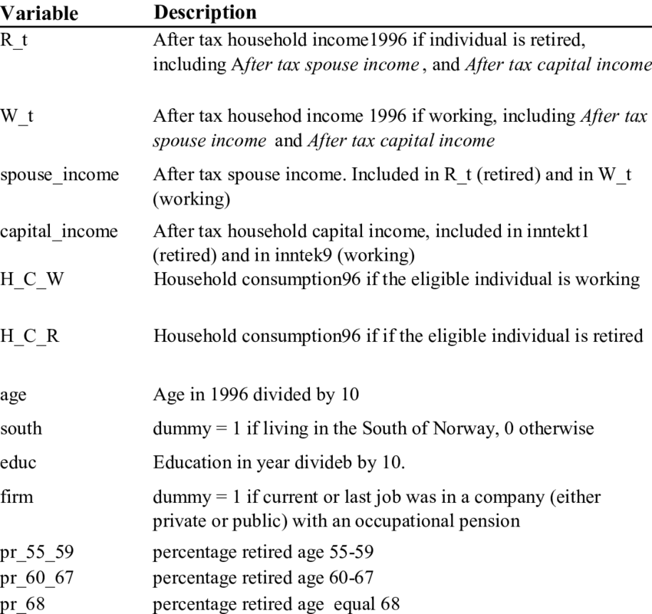
Dataset Description
Where you get the dataset?
How many rows are in the dataset?
How many variables?
What are the variables in the dataset?
For example, you can say that the dataset consists of 150 records with 13 variables with the description as shown in the table here.
‹#›

Slide 5
Histogram
Minitab Output
R Output

Slide 6
Bar Chart
Minitab Output
R Output

Slide 7
Pie Chart
Minitab Output
R Output

Slide 8
Stem and Leaf
Minitab Output
R Output

Slide 9
Conclusion

